Slide 1
Threads
Lecture on creating and joining threads

Slide 2
What is a thread?
A thread is a sequence of instructions that can be executed in parallel with other threads
Threads of a program are not full-blown processes, but are smaller portions of the process running concurrently (or in parallel). Hence, the term lightweight is used

Slide 3
Needles and Threads
A thread is a fibre used in sewing with a needle
Think of this
Think of sewing needles as the CPUs and the threads in a program as the fibre. If you had two needles but only one thread, it would take longer to finish the job than if you split the thread into two and used both needles at the same time.
Taking this analogy a little further, if one needle had to sew on a button (blocking I/O), the other needle could continue doing other useful work even if the other needle took 4 hours to sew on a single button. If you only used one needle, you would be ~4 hours behind
We will see the term LWP or lightweight process being used

Slide 4
Threads and Processes
In traditional single-threaded process systems, a process has a set of properties. In multi-threaded systems, these properties are divided between processes and threads.

Slide 5
Single and Multi-threading
Single threading
This is a process with only one thread of control so is essentially a single process or one processing one command at a time.
Multithreading
Allows applications to manage a, separate, process with several threads of control; This allows the OS to emulate a system with multiple processors and a common memory.
In reduces overheads associated with swapping the whole process in and out of memory.
In other words different parts of the program can be run concurrently in a single processor system or in parallel in a multi-processor system.

Slide 6
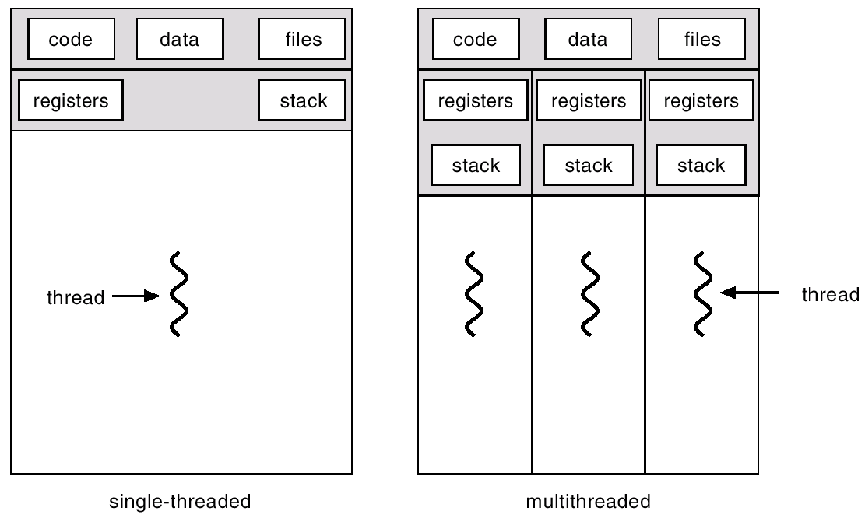
Single and Multithreaded Processes
THREADS

Slide 7
Examples of multithreading
Examples of multithreading:
Multiple queries to a database (a separate thread for each query);
Multiple connections TCP connections: a separate thread to deal with each connection.
An application that has a processing element and an i/o element where one thread processing and one thread to deal with the I/O
A word processor will have many threads; one for inputting data, one for backup or archiving the word document…

Slide 8
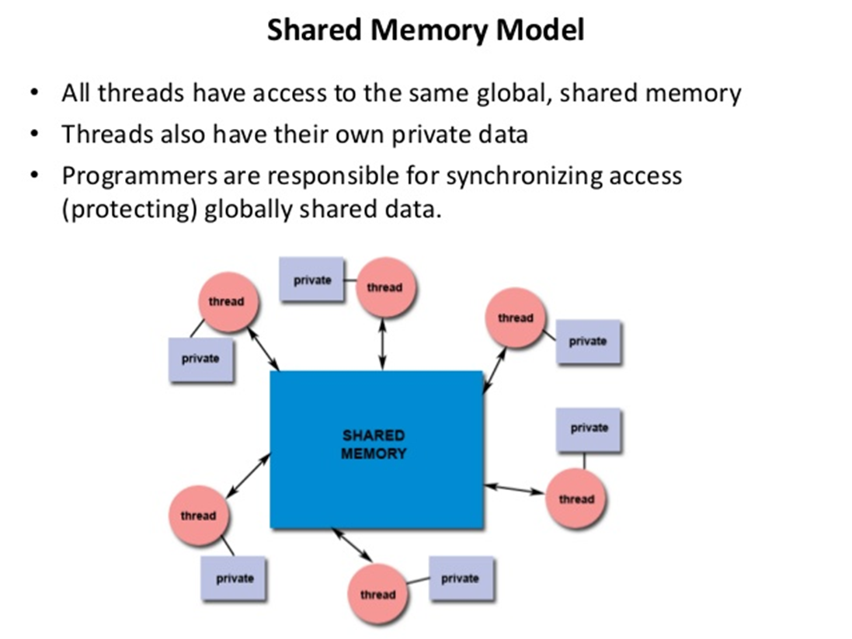
Property of multi-threading

Slide 9
Thread properties
A thread is the schedulable entity. It has only those properties that are required to ensure its independent flow of control. These include the following properties:
Stack
Scheduling properties (such as policy or priority)
Set of pending and blocked signals
Some thread-specific data.
Threads within a process must not be considered as a group of processes. All threads share the same address space. This means that two pointers variables having the same value in two threads refer to the same data. Also, if any thread changes one of the shared system resources, all threads within the process are affected; e.g. Closing files… shared address…

Slide 10
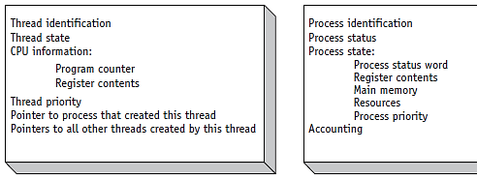
(figure 4.4)
Comparison of a typical Thread Control Block (TCB) vs. a Process Control Block (PCB). © Cengage Learning 2014

Slide 11
Thread Creation and Implementation
The Initial Thread
When a process is created, one thread is automatically created. This thread is called the initial thread. It ensures the compatibility between the old processes with a unique implicit thread and the new multi-threaded processes. The initial thread has some special properties, not visible to the programmer, that ensure binary compatibility between the old single-threaded programs and the multi-threaded operating system. It is also the initial thread that executes the main routine in multi-threaded programs.
Threads Implementation
A thread is the schedulable entity, which means that the system scheduler handles threads. These threads, known by the system scheduler, are strongly implementation-dependent. To facilitate the writing of portable programs, libraries provide another kind of thread.

Slide 12
Thread States
Operating systems must be able to:
Create new threads
Set up a thread so it is ready to execute
Delay, or put to sleep, threads for a specified amount of time
Block, or suspend, threads waiting for I/O to be completed
Set threads to a WAIT state until a specific event occurs: until another thread finishes execution
Schedule threads for execution
Terminate a thread and release its resources

Slide 13
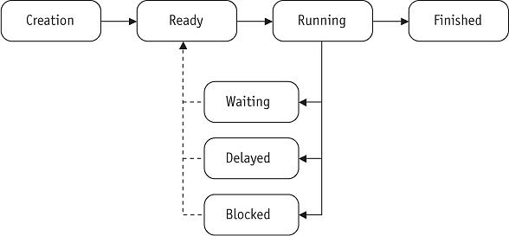
(figure 4.3)
A typical thread changes states from READY to FINISHED as it moves through the system. © Cengage Learning 2014

Slide 14
Thread States (cont’d.)
Thread transitions
Application creates a thread: placed in READY queue
READY to RUNNING: Process Scheduler assigns it to a processor
RUNNING to WAITING: when dependent on an outside event, e.g., mouse click, or waiting for another thread to finish
WAITING to READY: outside event occurs or previous thread finishes

Slide 15
Thread States (cont’d.)
Thread transitions (cont’d.)
RUNNING to DELAYED: application that delays thread processing by specified amount of time
DELAYED to READY: prescribed time elapsed
RUNNING to BLOCKED: I/O request issued
BLOCKED to RUNNING: I/O completed
RUNNING to FINISHED: exit or termination
All resources released

Slide 16
Programming Preliminaries
Include pthread.h in the main file
Compile program with –lpthread
gcc –o test test.c –lpthread
may not report compilation errors otherwise but calls will fail
Good idea to check return values on common functions

Slide 17
Creating Threads:
Initially, your main() program comprises a single, default thread. All other threads must be explicitly created by the programmer.
pthread_create creates a new thread and makes it executable. This routine can be called any number of times from anywhere within your code.

Slide 18
Thread creation
Types: pthread_t –data type ( thread)
Some calls:
int pthread_create(pthread_t *thread,
pthread_attr_t *attr,
*start_routine,
void *arg);
void pthread_exit();
No explicit parent/child model, except main thread holds process info
Call pthread_exit in main, don’t just fall through;

Slide 19
pthread_create arguments:
*thread: A unique identifier (pointer) for the new thread returned by the subroutine.
attr: An attribute object that may be used to set thread attributes (joinable, detach, stack size…). You can specify a thread attributes object, or NULL for the default values. (more detail here thread_attributes)
*start_routine: the C routine that the thread will execute once it is created.
arg: A single argument that may be passed to start_routine. It must be passed by reference as a pointer cast of type void. NULL may be used if no argument is to be passed. Be aware that this single argument can also be an array of arguments (but this is still only a pointer

Slide 20
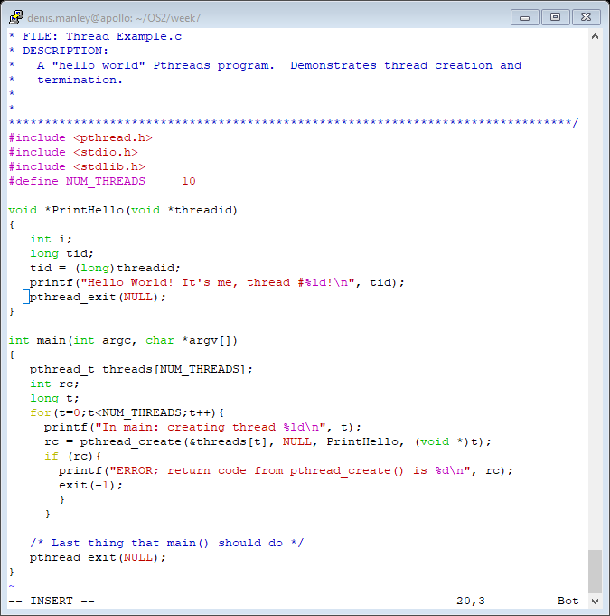
Create Basic Thread example

Slide 21
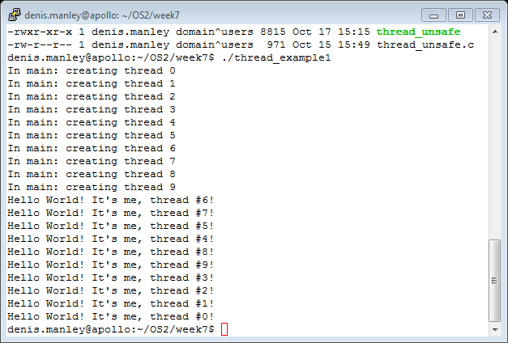
Thread example 1 with pass int

Slide 22
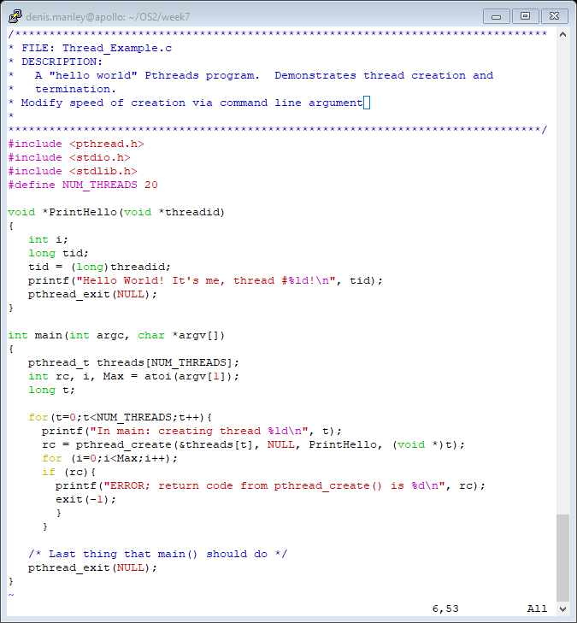
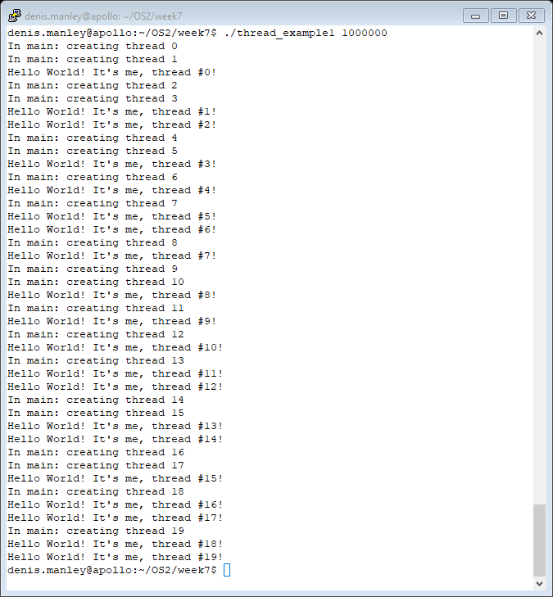
Modify Scheduling output
Delay creation of threads

Slide 23
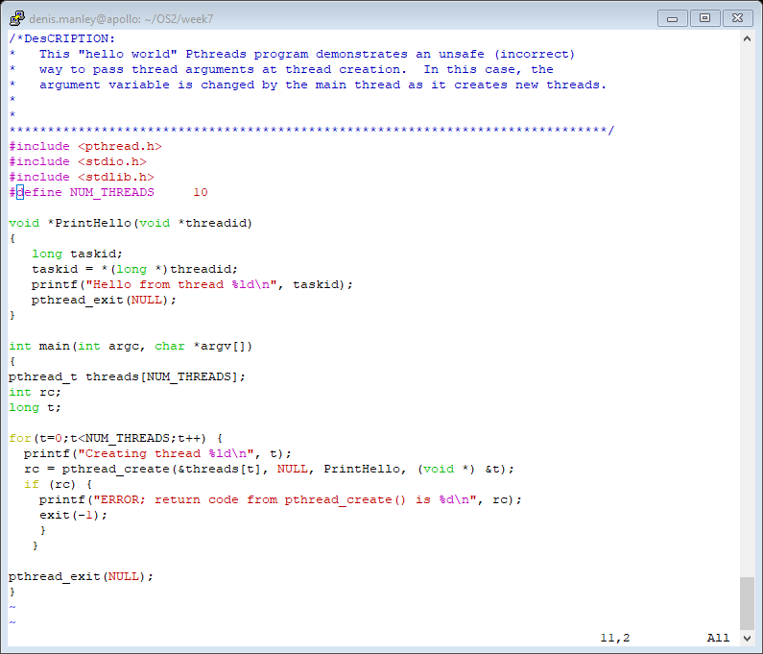
Code to demonstrate shared memory

Slide 24
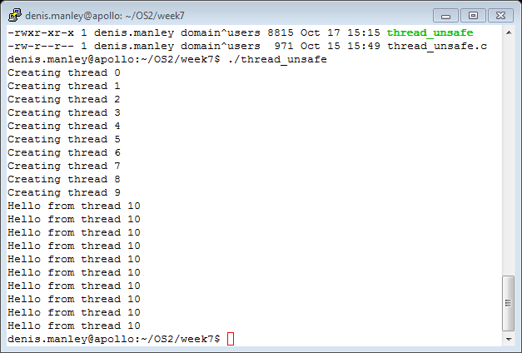
Thread_1 unsafe pass pointer &t and not t

Slide 25
Modify to delay thread creation
Modify the unsafe code to delay the creation of threads: the delay time is input via command line: hint refer to modified safe code.
Remove the delay code from within the thread.
Refer to the following slide for code

Slide 26
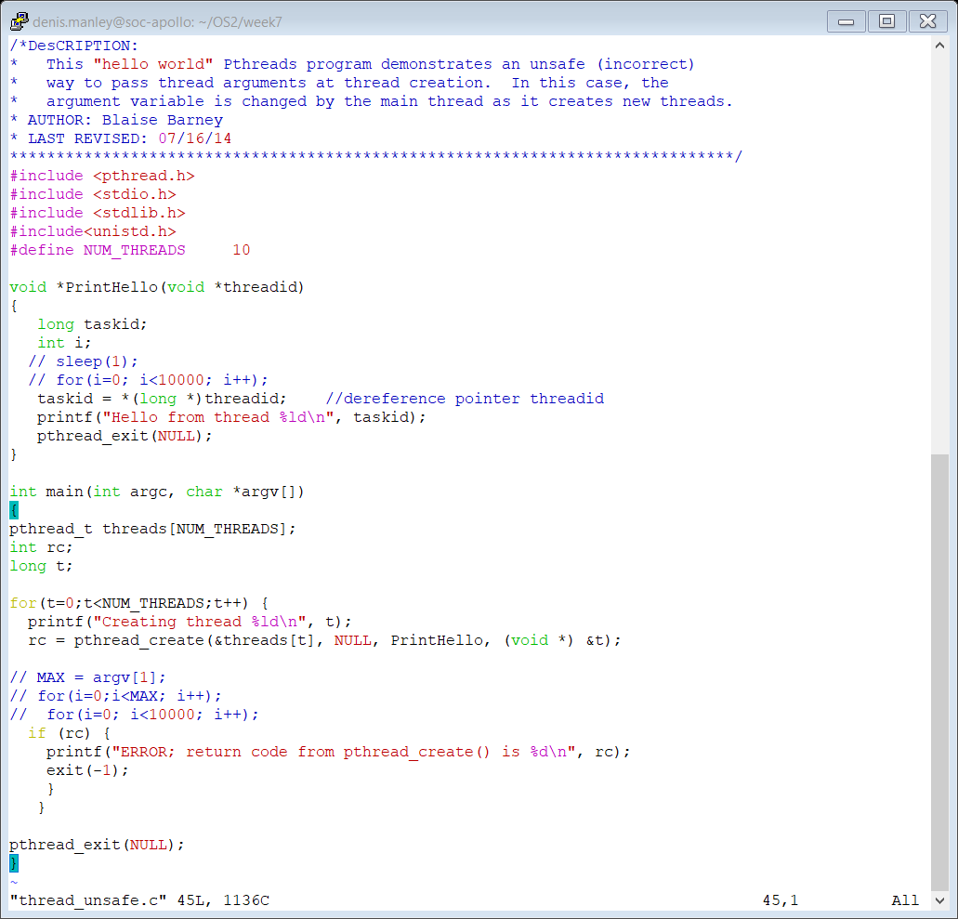
Modified thread_unsafe.c
Slow processing

Slide 27
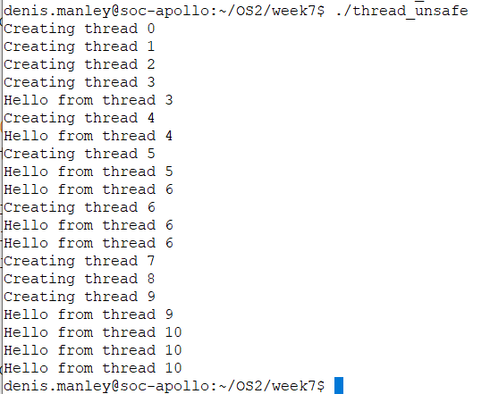
Modify Thread_1 unsafe .c to delay thread creation

Slide 28
A Warning of working with threads
For example, if a thread closes a file, the file is closed for all threads
If the arg passed in the create function does not take into account the data is shared between threads it may result in unforessen errors:
see thread_unsafe.c
In this example the variable t is passed by reference and its is data common to each thread so the “by reference” can change its value so it could lead to problems.
rc = pthread_create(&threads[t], NULL, PrintHello, (void *) &t);
The &t refers to t and t is a shared variable

Slide 29
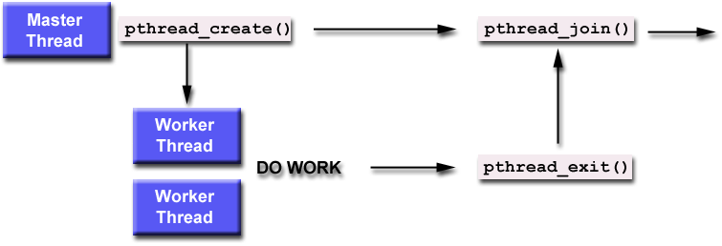
Illustration of thread join

Slide 30
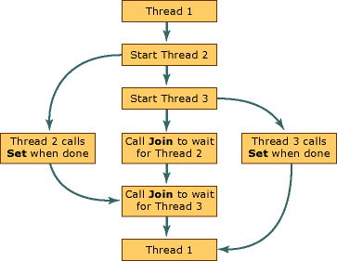
Thread join (with two threads)

Slide 31
Thread Joining
Joining is similar to wait()
"Joining" is one way to accomplish synchronization between threads.
The pthread_join() subroutine blocks the calling thread until the specified threadid thread terminates.
On success, pthread_join() returns 0; on error, it returns an error number.
The thread specified by thread must be joinable.
This is a way to ensure that the process itself does not terminate before the threads and so destroy (not execute) the threads

Slide 32
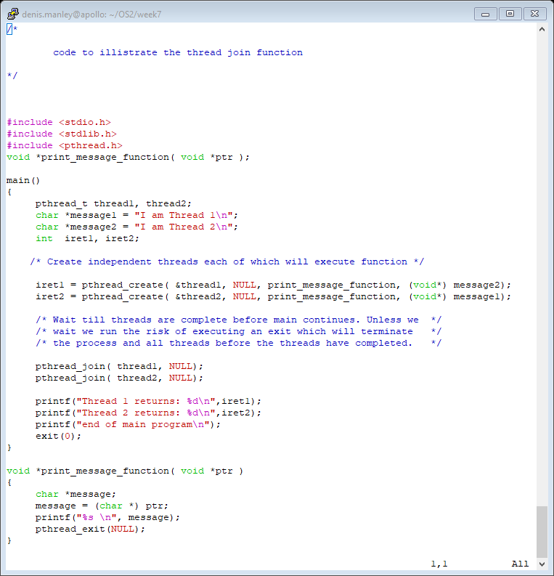
Example thread join

Slide 33
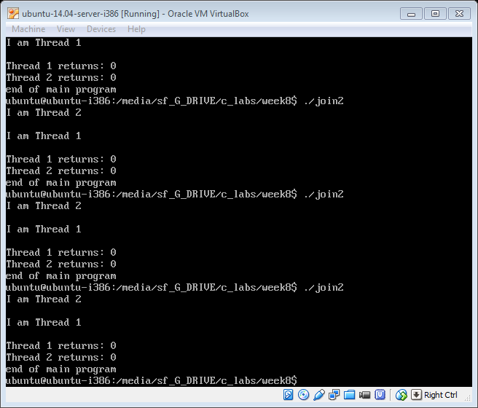
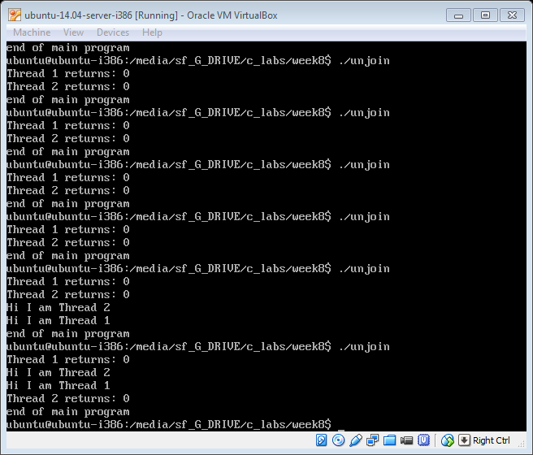
Run the following to programs to see the effect of the pthread_join() function ThreadJoin.c and ThreadUnjoin.c. sample output

Slide 34
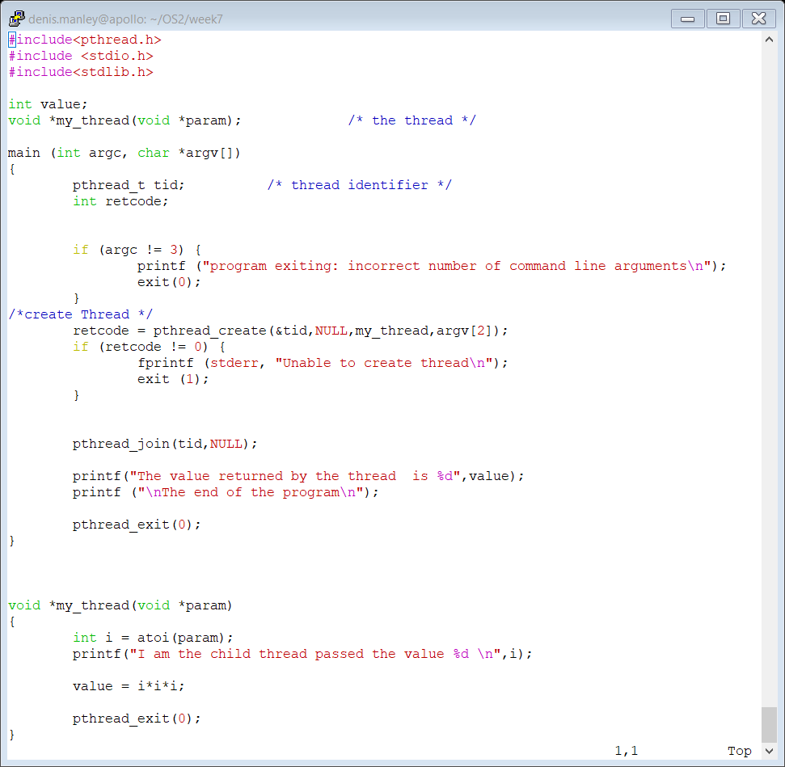
Pass command argument to Thread

Slide 35
Joinable or Not?
When a thread is created, one of its attributes defines whether it is joinable or detached. Only threads that are created as joinable can be joined. If a thread is created as detached, it can never be joined.
The final draft of the POSIX standard specifies that threads should be created as joinable. It is by default.

Slide 36
Other synchronisation methods
Two other synchronization methods, mutexes and condition variables, will be discussed later.
Semaphores is another type of synchronisation method used to prevent shared memory problems.

Slide 37
Some Performance Considerations
The performance gains from using threads is great, but can it be even better? You should consider the following when analyzing your program for potential bottlenecks:
Lock granularity - How "big" (coarse) or "small" (fine) are your mutex locks? Do they lock your whole structure or fields of a structure? The more fine-grained you make your locks, the more concurrency you can gain, but at the cost of more overhead and potential deadlocks.
Lock ordering - Make sure your locks are always locked in an agreed order (if they are not, make sure you take steps to rectify situations where locks are obtained in an out-of-order fashion, e.g. by using trylock/unlock calls).
Lock frequency - Are you locking too often? Locking at unnecessary
times? Reduce such occurences to fully exploit concurrency and reduce synchronization overhead.
Critical sections - This has been mentioned before (twice), but you should take extra steps to minimize critical sections which can be potentially large bottlenecks.

Slide 38
Sample question
What is a thread control block (4 marks).
Distinguish between a single and a multi-threading system. (4 marks)
Give two examples of multi-threading (4 marks)
What are the main states that a thread can undergo (8 marks)

Slide 39
Sample Questions
To create a thread in posix C programming a number of parameter are required. Explain in your own words what each of the following parameters of the thread function mean:
int pthread_create(pthread_t *tidp, const pthread_attr_t *attr, *start_rtn, void *restrict arg) (8 marks)

Slide 40
Sample Question
Explain the code for the threadjoin.c program (you will be given the code without comments) (8 marks)
Explain, using sample output, what will happen if the two “thread_join” statements were removed (6 marks)
You will be given the above code in the exam. (you are not expected to remember and write these programs)

Slide 41
Reference material
Kernal threads: The programmer has no direct control over these threads, unless writing kernel extensions or device drivers. See AIX Version 4.3 Kernel Extensions and Device Support Programming Concepts for more information about kernel programming.
Posix threads:

